Slide 1
Customer Churn Analysis
Jayant Sail

Slide 2
Problem Statement
Customer churn is a major challenge for companies, as losing customers directly impacts revenue and growth. The purpose of this project is to analyze customer data to understand customer behavior, identify key factors influencing churn, and uncover patterns that help businesses reduce customer attrition.

Slide 3
Objective
Identify the key factors that are driving customer churn.
Understand customer behavior toward company's services.
Generate data driven insights that help business to reduce churn and improve customer retention strategies.

Slide 4
Overview of dataset
This is a Telecom Customer Churn dataset downloaded from Kaggle. It contains 7,043 records and 38 columns including customer demographic, services, billing, and churn information.
Key Columns Include:
Demographic: Age, Gender, Marital Status, Number of Dependents.
Customer Relationship: Tenure in Months, Number of Referrals.
Billing: Contract, Payment Method, Paperless Billing, Monthly Charge.
Revenue: Total Charges, Total Revenue.
Target Variables: Customer Status, Churn Category, Churn Reason.

Slide 5
Tools I’ve used
Tools: Google colab
Programming language: Python
Data visualization: Matplotlib, Seaborn
Data manipulation: Pandas

Slide 6
Data cleaning insights
This dataset contains no duplicate values.
All numerical columns fall within the valid range
All columns have correct datatypes(object, int64 and float64).
Identified issue:
Some records show monthly charge in negative.

Slide 7
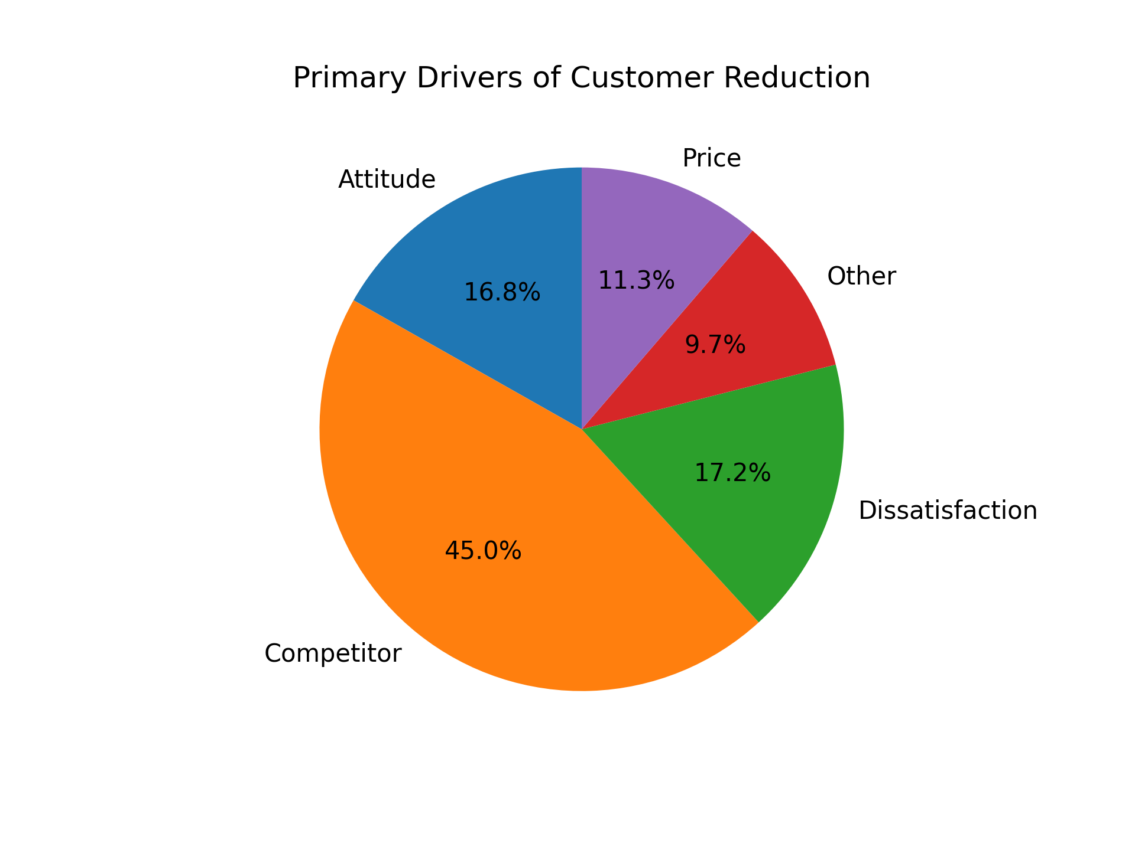
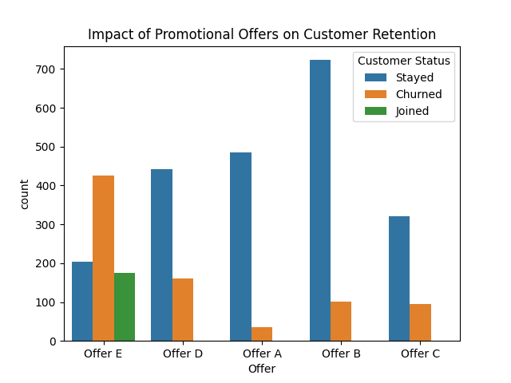

Slide 8
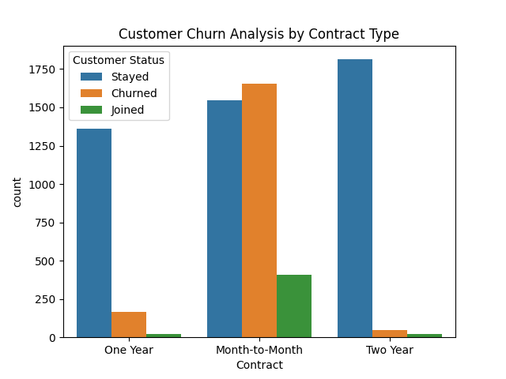

Slide 9
Other Key Insights
Customer Status Distribution: 4720 stayed, 1869 churned, and 454 newly joined.
Most customers use month-to-month contracts, while the rest are evenly split between 1-year and 2-year contracts.
Age & Gender don’t influence the churn rate of customers.
More than 50% of customers haven’t referred to anyone while only 1k customers referred to only 1 person.
Customers tend to leave once their monthly bill crosses ₹80, while new joiners usually choose plans cheaper than ₹60(without internet service).
Unmarried customers and customers who have 0 dependents show high churn rate than married and have 1 or more dependents.
Customer using internet services has higher churn rate than the customers who don’t.

Slide 10
Other key insights
Customers using fiber optic cable as their internet type are more likely to leave compared to other internet type.
Contract type, tenure and Offer type are the main things influencing the churn rate.

Slide 11
Solutions
Introduce new affordable plans for customers who are tight on their budget.
Offer flexible mid-range plans with benefits, since customers are either buying cheap or premium plans.
Push month to month customers to 1 or 1.5 years by providing incentives like cashback, bonus data or data rollover(like VI).
Make customer support more helpful and give customers easy service options on the app or website and improve the customer support staff’s behavior.
Launch referral bonus for customers who refer for more 2 or more people.
Review offers giving negative response, resolve the issue and find solution and promote the positive response

Slide 12
Thank You!

